Slide 1
COP4020 – Programming Languages
App Wars:
Programming for Android and Apple Devices

Slide 2
A Study in Contrasts…
Closed vs Open Environments

Slide 3
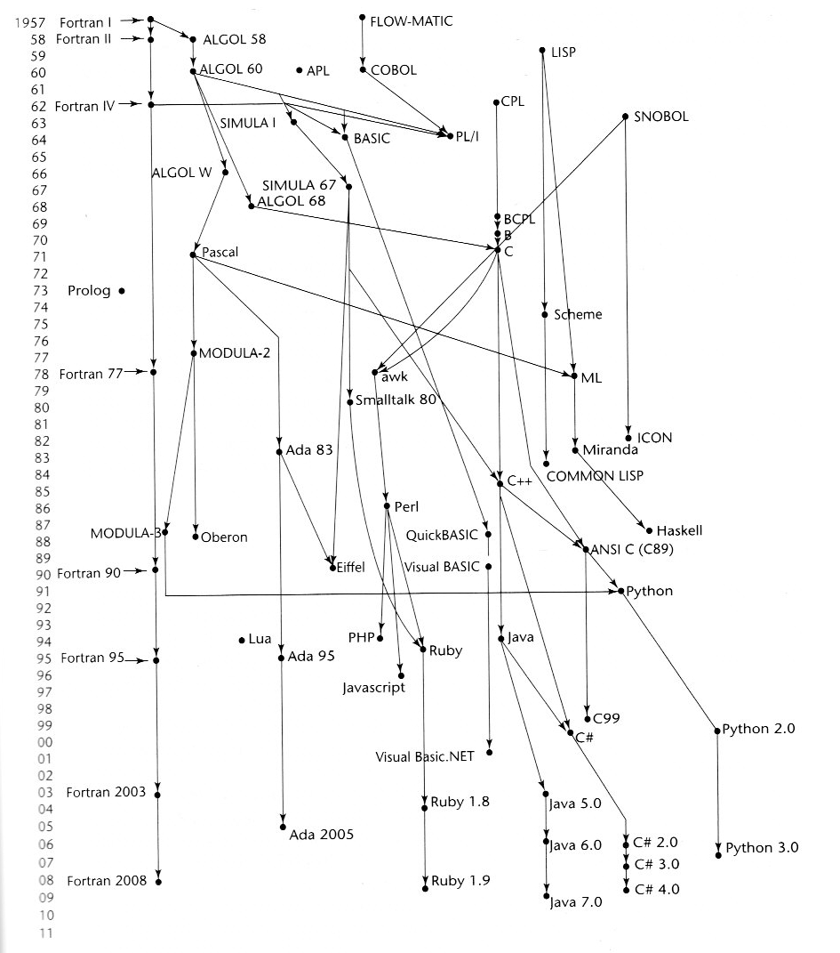
Objective C
Swift

Slide 4
iOS, OS X, and iPhone
Objective C at Wikipedia
Swift at Wikipedia

Slide 5
Android Development
Android Software Development Kit (SDK)

